Slide 1
Manual for Imputation

Slide 2
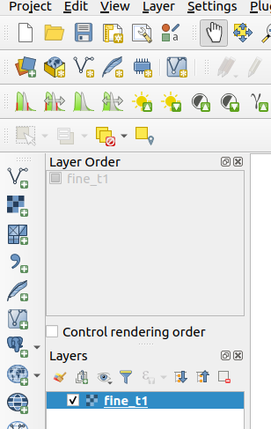
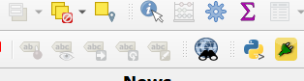
Load raster files into QGIS.
Install imputation plugin from zip file (Refer Installation manual).
Step 1: Load Raster Files
Step 2 : Click on the icon

Slide 3
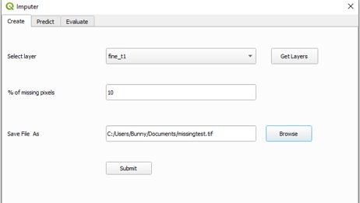
Creating Missing Pixels for Imputation
Imputation GUI appears as below.
Step 3 : Click on Get Layers button.
Step 4 : Select layer from combo box.
Step 5 : Enter % of missing pixels.
Step 6 : Click browse button, select
output directory and enter output file name.
Step 7 : Click on submit button to run
the program.
Step 4
Step 3
Step 5
Step 6
Step 7

Slide 4
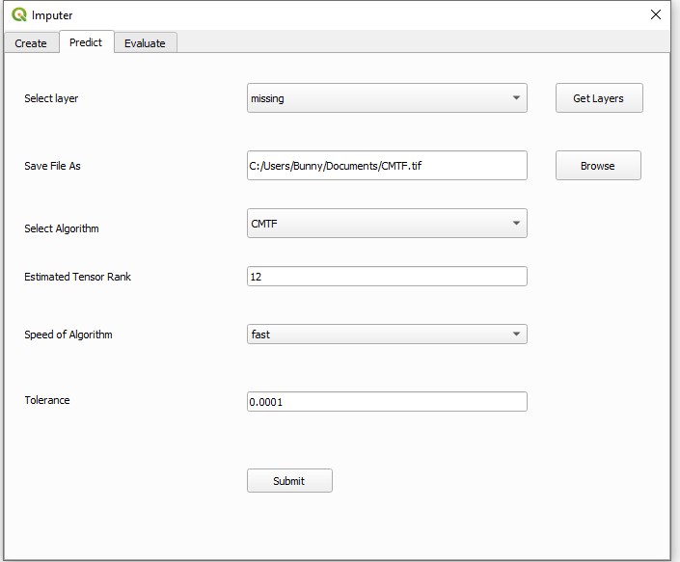
Predicting Missing Pixels
Step 1 : Click on Predict tab.
Step 2 : Load missing pixels file into QGIS.
Step 3 : Click on Get Layers button.
Step 4 : Select layer from combo box.
Step 5 : Click browse button, select
output directory and enter output file name.
Step 6: Select Algorithm from combo box and
enter tensor rank. (Recommended : CMTF)
Step 7 : Select speed of Algorithm.
Fast – less iterations, Slow – more iterations.
Enter tolerance(default : 0.0001)
Step 8 : Click on submit button to run
the program.
Step 1
Step 4
Step 3
Step 5
Step 6
Step 7
Step 8

Slide 5
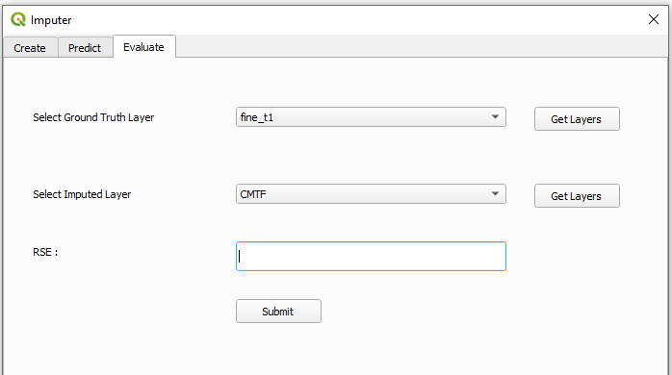
Evaluation
Step 1 : Click on Evaluate tab.
Step 2 : Load imputed file into QGIS.
Step 3 : Click on Get Layers button.
(for ground truth and imputed layer)
Step 4 : Select ground truth layer from
combo box.
Step 5 : Select imputed layer from
combo box.
Step 6 : Click on submit button and the
RSE value is displayed.
Step 1
Step 4
Step 3
Step 5
Step 3
Step 6

Slide 6


